Slide 1
Class, Ethnicity, age or Education: What Characteristics Determine Citizens’ Sense of Political Commonality? Author: Noam Titelman (2023)
Replication Study
By Aryan Goyal

Slide 2
Original study
Existing literature has focused largely on how demographic characteristics (Ethnicity, Age) themselves explain vote choice
The author wants to determine which social identities are more important for how people perceive political commonality between themselves and other citizens
This study has 2 goals:
Expand this to understand which characteristics (Gender, ethnicity etc) have been politicized in the context of the United Kingdom
Checks if there is a pattern for which characteristics are valued by Labour vs Conservative and Remain vs Leave voters
The original study does not explicitly state any hypotheses
The goal of the study is to figure out the probability of a respondent choosing one profile if that profile shares an attribute with the respondent and the other alternative profile does not.
Notes:
He believes analysing the associations between demographic groups and voting does not reveal the relative importance of the corresponding social identities to politics

Slide 3
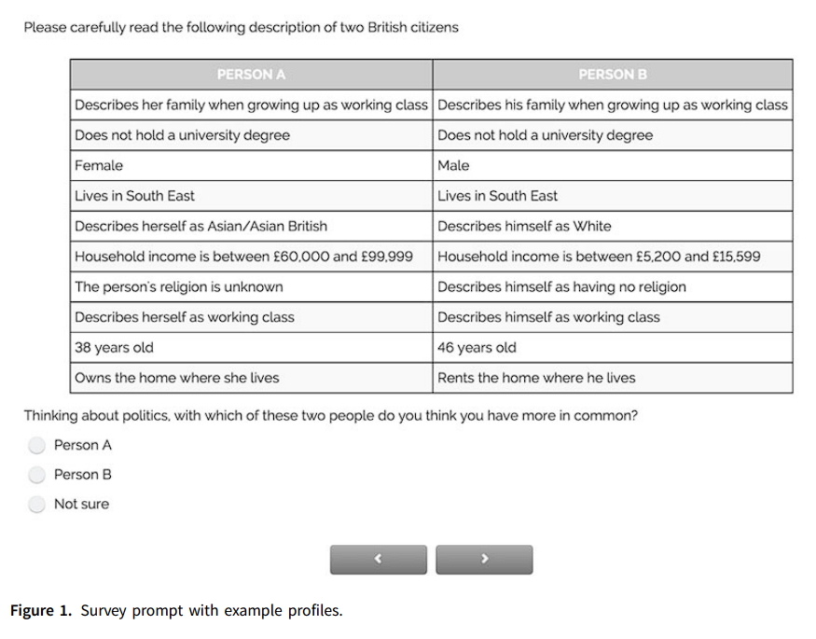
Original Study
Respondents are presented with the profiles of two citizens, including several demographic attributes.
Respondents are asked which of the two they perceive themselves to have more in common with in terms of politics

Slide 4
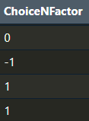
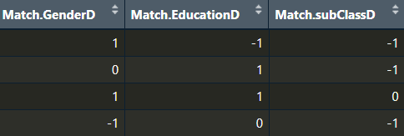
Data
Input variable: Does [characteristic] of respondent match with [characteristic] in profile
Coded as:
[Characteristic] matches in Profile A = 1
Matches in both/neither = 0
[Characteristic] matches in Profile B = -1
Outcome variable: ChoiceNFactor (Respondents’ choice of profile)
Coded as:
Respondent chooses Profile A = 1
Not sure = 0
Respondent chooses Profile B = -1
Notes:
Example of how Gender

Slide 5
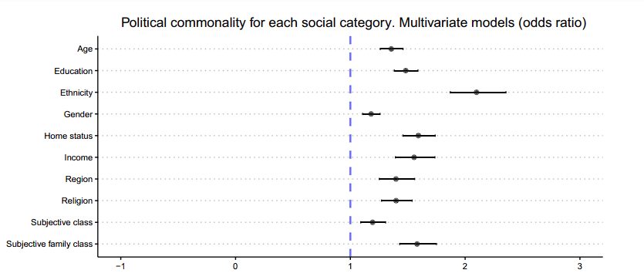
original study’s model
The author runs an ordinal logistic regression model
All the matching coefficients are statistically significant at the 95 per cent confidence level.
The coefficients correspond to how strongly a respondent matching a profile on a given attribute predicts the respondent choosing that profile as having more political commonality with themselves.
This confirms that, on average, people are more likely to feel political commonality with people who share their social identity categories for all the characteristics in the study.
Notes:
Respondents are most likely to feel political commonality with those who share ethnicity

Slide 6
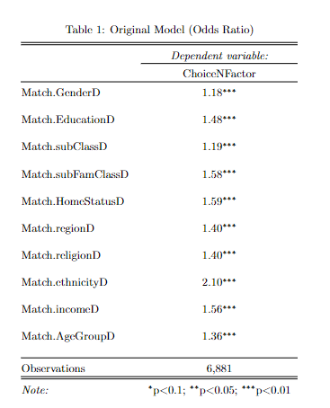
My contribution
Issues with current study:
Original study has a confusing ordinal scale
This model is hard to interpret intuitively in the manner that we have learned in this class
How to substantively interpret the original model?
For a 1 unit increase in Gender (going from Gender of respondent matches in Profile B to no match/both match), the odds of moving to a higher category on the ChoiceNFactor variable (going from choosing Profile B to not sure or from not sure to picking Profile A) increase by a multiplicative factor of 1.18, holding all other variables constant.

Slide 7

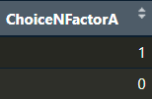
My contribution
My solution:
Relevel the variables to a dummy variable (0 and 1)
Input variable:
1 = The [characteristic] of respondent matches the profile
0 = No match
Run a logistic regression model instead
Outcome variable:
1 = Respondent chose Profile A
0 = Respondent does not choose Profile A
Notes:
In this case, the Match.GenderA variable tells us that the gender of the respondent matches the gender in Profile A and choiceNFactor A just tells us if the respondent chose that profile or not

Slide 8
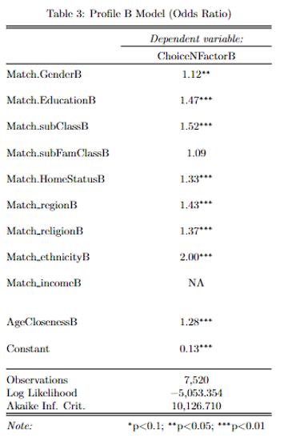
Comparing models
What does this model represent?
This model explains the odds of a respondent picking Profile B if the respondent’s [characteristic] matches the [characteristic] in profile B
Example interpretation:
When the respondent’s ethnicity matches the one in Profile B, the odds of the respondent selecting Profile B increase by a multiplicative factor of 2.00 on average, while holding all other variables constant
Findings from this model:
The odds ratio values are generally similar to the original model
The coefficient for Family class is not significant anymore
This model also raises questions:
The original dataset has no instances where the income of the respondent matches the income of Profile B

Slide 9
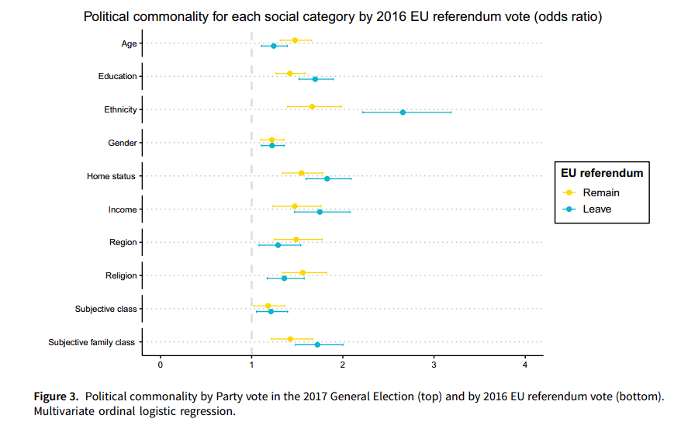
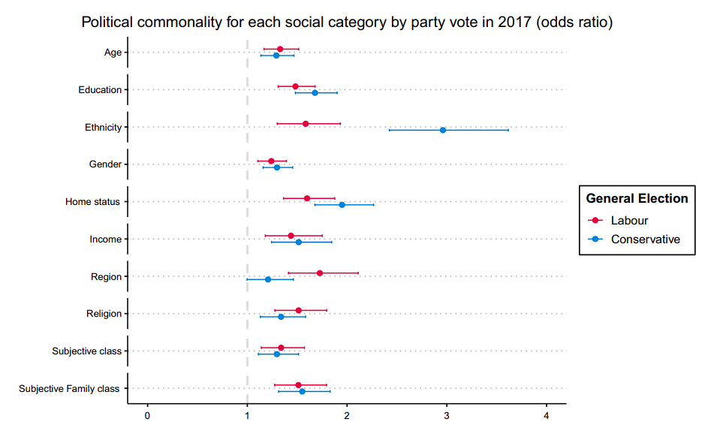
Figure 3 from original study

